Slide 1

6th Grade
Unit 4, Lesson 1 Rational Numbers and the Number Line – Part 1 Volume 1, pg. 135

Slide 2


Benchmark
MA.6.NSO.1.1
Extend previous understanding of numbers to define rational numbers. Plot, order, and compare rational numbers.
MA.6.NSO.1.2
Given a mathematical or real-world context, represent quantities that have opposite direction using rational numbers. Compare them on a number line and explain the meaning of zero within its context.
volume 1, pg. 135

Slide 3
Integrated Mathematical Thinking and Reasoning Standards
MA.K12.MTR.1.1 Actively participate in effortful learning both individually and collectively.
MA.K12.MTR.4.1 Engage in discussions that reflect on the mathematical thinking of self and others.
MA.K12.MTR.5.1 Use patterns and structure to help understand and connect mathematical concepts.
volume 1, pg. 135

Slide 4

Learning Targets
I can demonstrate an understanding of negative numbers.
I can recognize that a number in the real number system can have a variety of classifications.
I can plot rational numbers on a horizontal and vertical number line.
volume 1, pg. 135

Slide 5

Warm-Up
volume 1, pg. 135

Slide 6

4.1.1 Warm-Up: Creating Zero
Use only digits $1$ to $9$, at most one time each, so that the equation is true.
Switch your answer with a partner to check. Ask your partner their strategy for finding their answer and write their strategy below.
volume 1, pg. 135

Slide 7

Exploration
volume 1, pg. 136

Slide 8

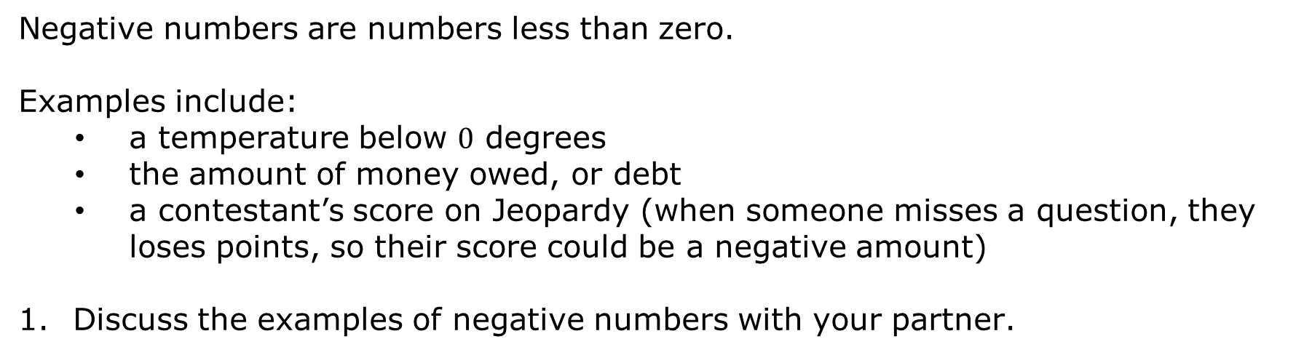
4.1.2 Exploration: How Can Negative Numbers Exist?
Negative numbers are numbers less than zero.
Examples include:
a temperature below $0$ degrees
the amount of money owed, or debt
a contestant’s score on Jeopardy (when someone misses a question, they loses points, so their score could be a negative amount)
Discuss the examples of negative numbers with your partner.
volume 1, pg. 136

Slide 9
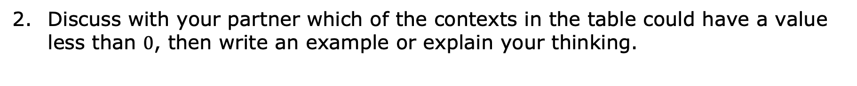
Discuss with your partner which of the contexts in the table could have a value less than $0$, then write an example or explain your thinking.
Context | Example or Explanation
Direction
Points in a game
Time
volume 1, pg. 136

Slide 10

Guided Instruction
volume 1, pg. 136

Slide 11


4.1.3 Guided Instruction: The Real Number System
The values in blue on the number line are some of the numbers in the set of natural numbers.
Natural numbers are the counting numbers $\{1, 2, 3, 4, 5…\}$.
volume 1, pg. 136

Slide 12



The values in red on the number line are some of the numbers in the set of whole numbers.
The values in green on the number line are some of the values in the set of integers.
Whole numbers are natural numbers and zero. $\{0, 1, 2, 3, 4, 5…\}$
Integers are whole numbers and their opposites. $\{…−4, −3, −2, −1, 0, 1, 2, 3, 4…\}$
volume 1, pg. 136

Slide 13
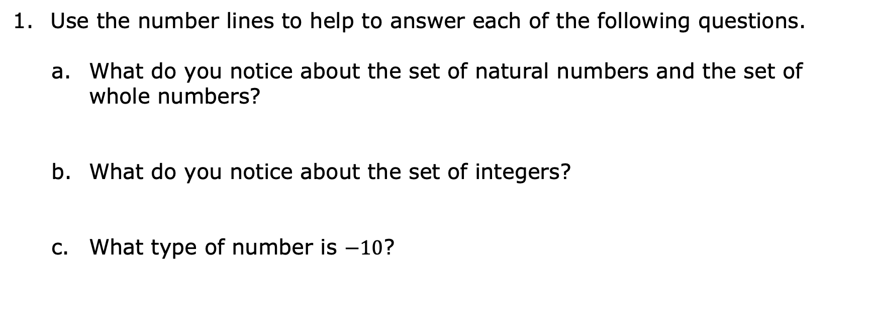
Natural numbers
Whole numbers
Integers
Use the number lines to help to answer each of the following questions.
What do you notice about the set of natural numbers and the set of whole numbers?
What do you notice about the set of integers?
What type of number is $−10$?
volume 1, pg. 137

Slide 14

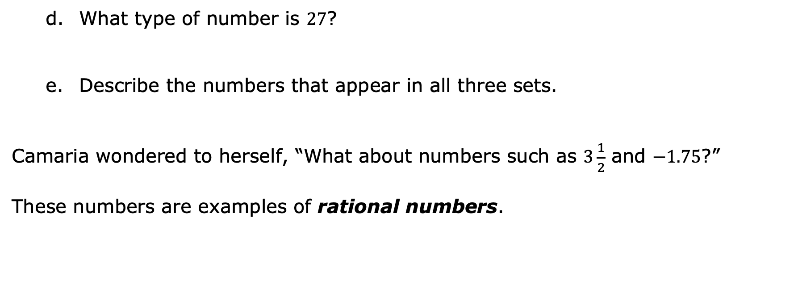
Natural numbers
Whole numbers
Integers
What type of number is $27$?
Describe the numbers that appear in all three sets.
Camaria wondered to herself, “What about numbers such as $3\frac{1}{2}$ and $−1.75$?”
These numbers are examples of rational numbers.
Rational numbers are numbers that can be expressed as the ratio of two integers.
volume 1, pg. 137

Slide 15
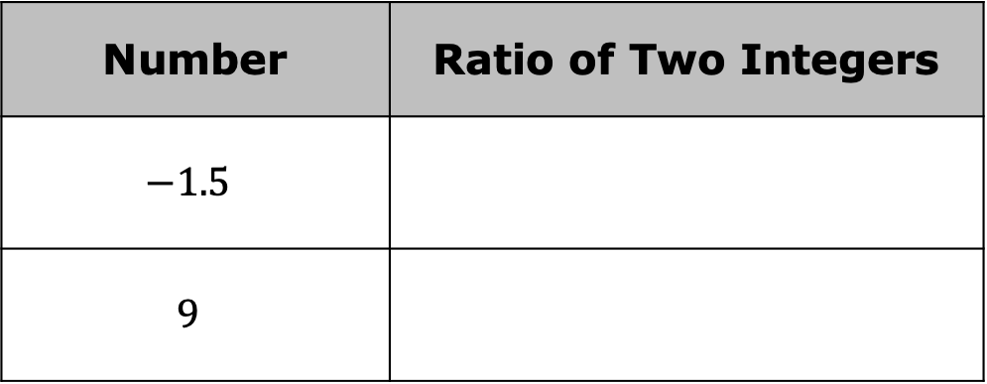
Use the definition of rational numbers to write each as a ratio of two integers.
In your study of mathematics, you will learn about irrational numbers, which are numbers that cannot be written as a ratio of two integers.
Number | Ratio of Two Integers
$$−1.5$$
$$9$$
The set of real numbers is the set of all rational and irrational numbers.
volume 1, pg. 137

Slide 16

Activity
volume 1, pg. 138

Slide 17

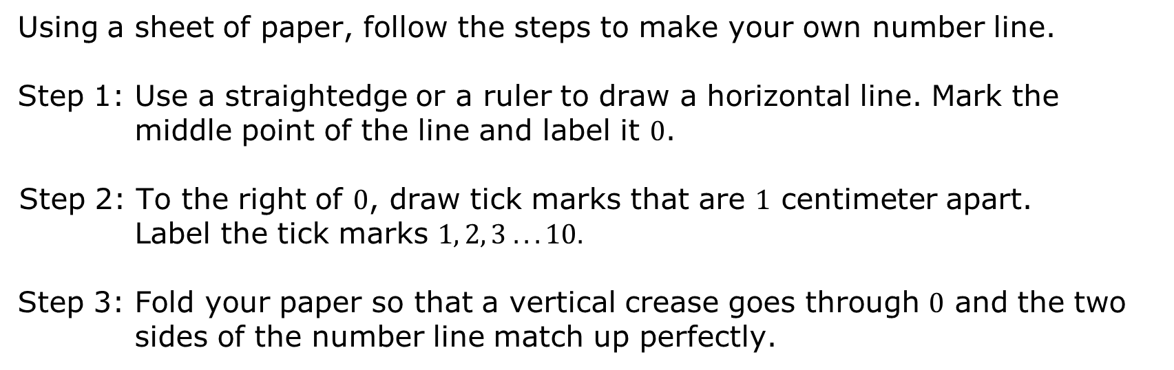
4.1.4 Activity: Horizontal Number Line
Using a sheet of paper, follow the steps to make your own number line.
Step 1: Use a straightedge or a ruler to draw a horizontal line. Mark the middle point of the line and label it $0$.
Step 2: To the right of $0$, draw tick marks that are $1$ centimeter apart. Label the tick marks $1, 2, 3 . . . 10$.
Step 3: Fold your paper so that a vertical crease goes through $0$ and the two sides of the number line match up perfectly.
volume 1, pg. 138

Slide 18
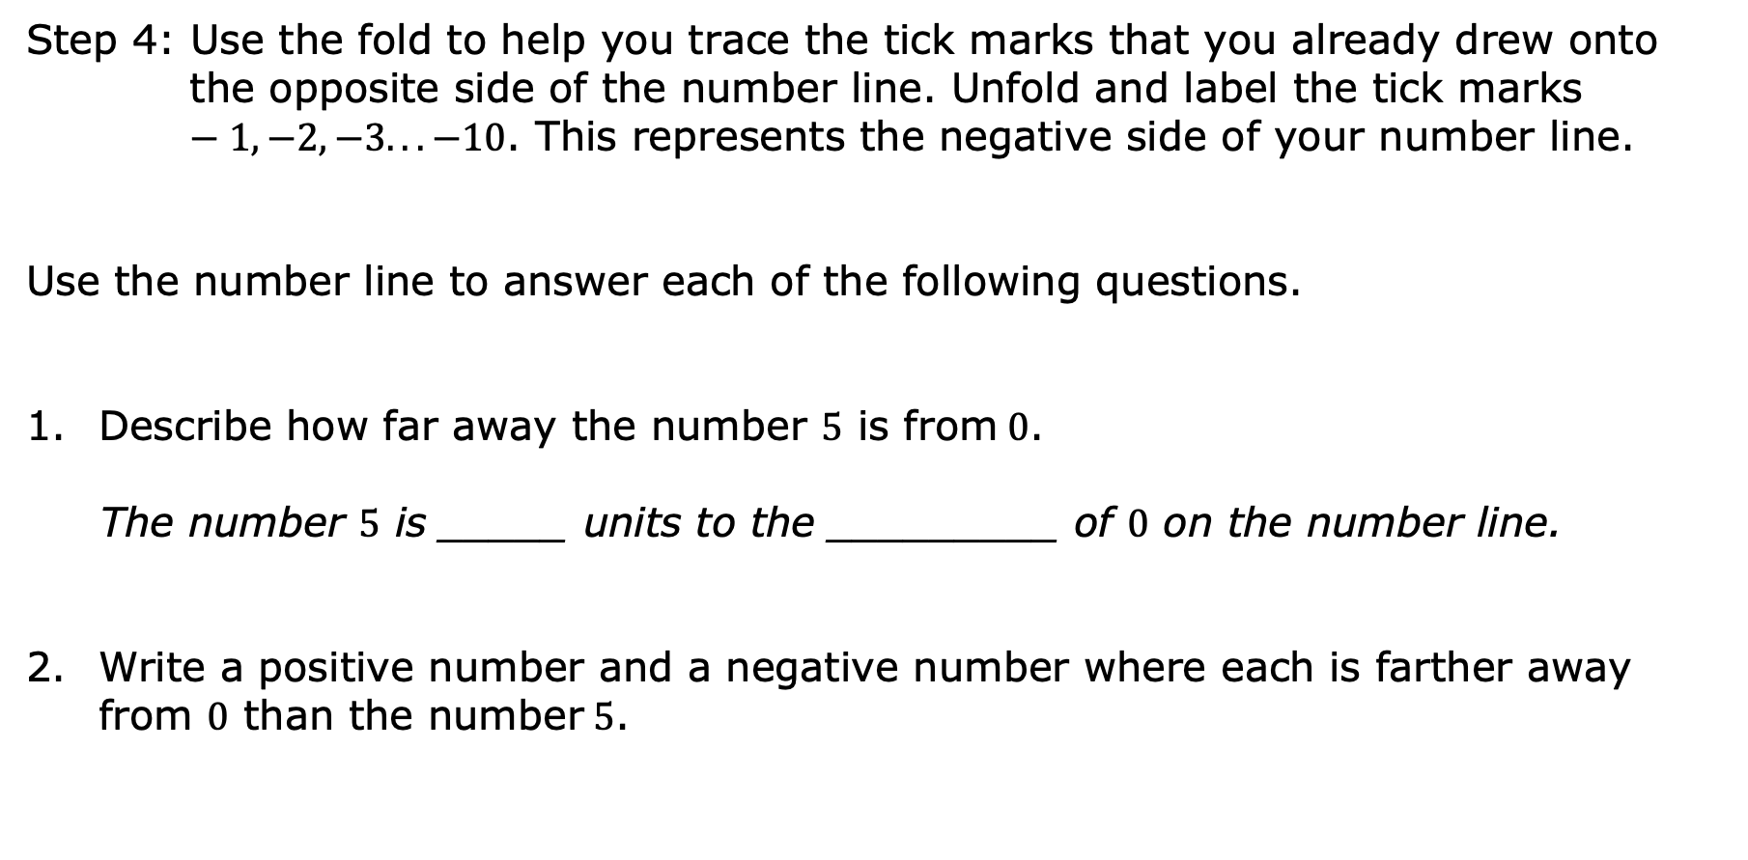
Step 4: Use the fold to help you trace the tick marks that you already drew onto the opposite side of the number line. Unfold and label the tick marks $−1, −2, −3. . . −10$. This represents the negative side of your number line.
Use the number line to answer each of the following questions.
Describe how far away the number $5$ is from$0$.
The number $5$ is _____ units to the _________ of $0$ on the number line.
Write a positive number and a negative number where each is farther away from $0$ than the number$5$.
volume 1, pg. 138

Slide 19

Describe how far away the number $−2$ is from$0$.
The number $−2$ is _______ units to the ________ of $0$ on the number line.
Write a positive number and a negative number that are each farther away from $0$ than $−2$.
volume 1, pg. 138

Slide 20

Bring It Together
volume 1, pg. 139

Slide 21

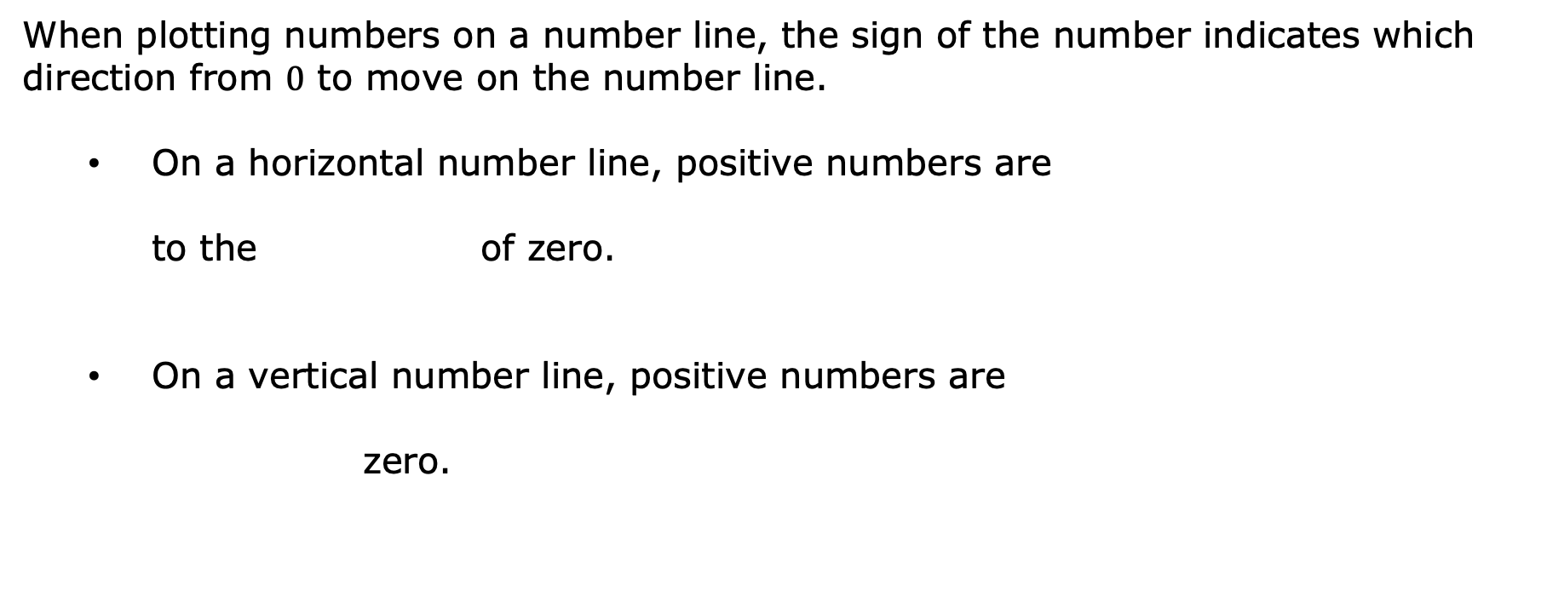
4.1.5 Bring It Together: Plotting Rational Numbers on Number Lines
When plotting numbers on a number line, the sign of the number indicates which direction from $0$ to move on the number line.
On a horizontal number line, positive numbers are
to the of zero.
On a vertical number line, positive numbers are
zero.
right
left
above
below
volume 1, pg. 139

Slide 22
On a horizontal number line, negative numbers are
to the of zero.
On a vertical number line, negative numbers are
zero.
right
left
above
below
volume 1, pg. 139

Slide 23


A number line is shown with points $P$, $X$, and $Y$.
What type of numbers are $P$, $X$, and $Y$?
Estimate the location of points $P$, $X$, and $Y$.
volume 1, pg. 139

Slide 24
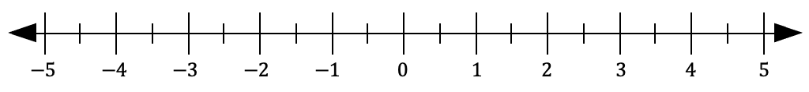
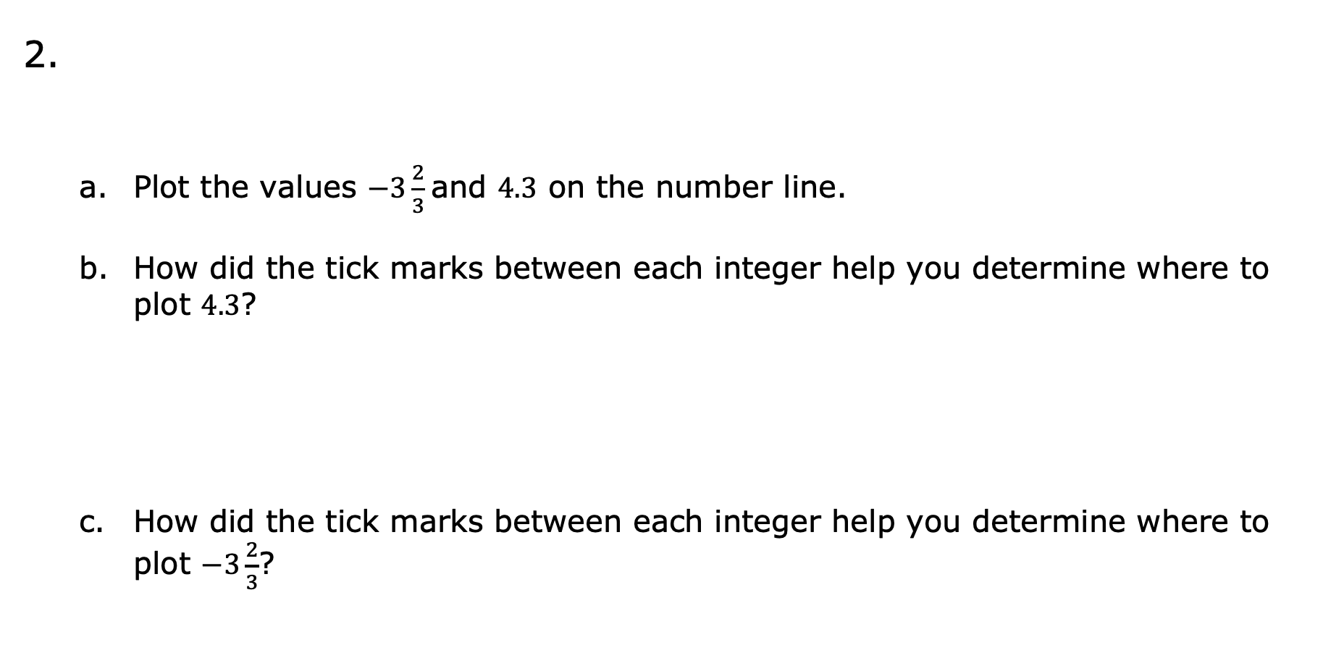
Plot the values $−3\frac{2}{3}$ and $4.3$ on the number line.
How did the tick marks between each integer help you determine where to plot $4.3$?
How did the tick marks between each integer help you determine where to plot $−3\frac{2}{3}$?
volume 1, pg. 139

Slide 25
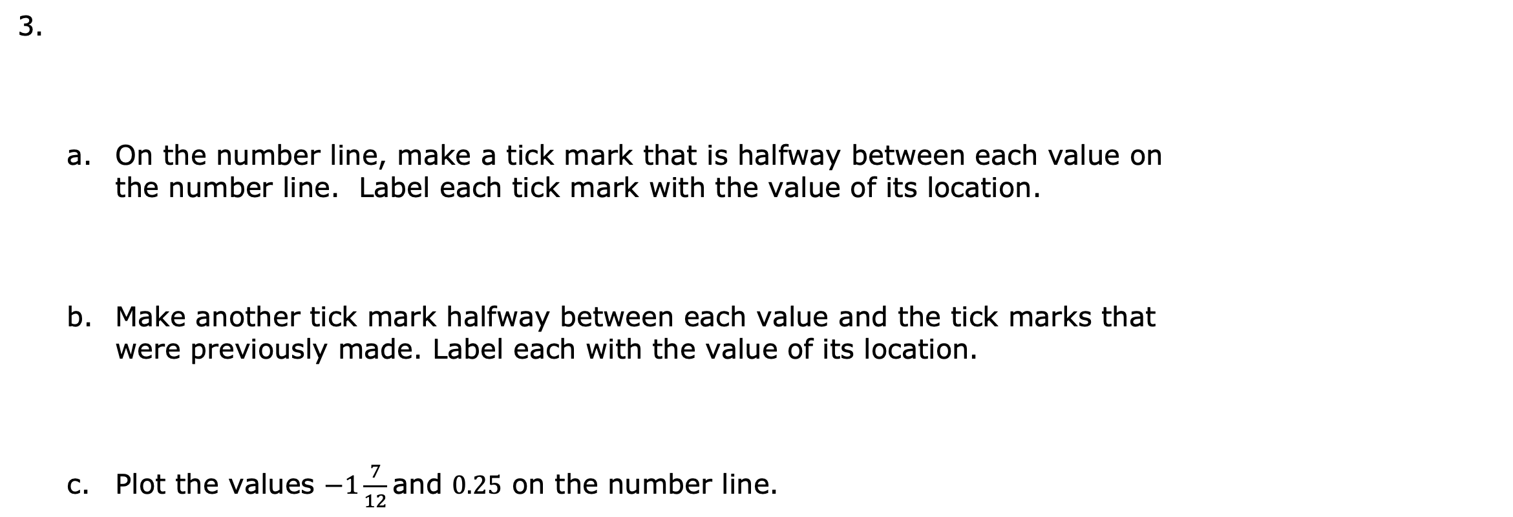
On the number line, make a tick mark that is halfway between each value on the number line. Label each tick mark with the value of its location.
Make another tick mark halfway between each value and the tick marks that were previously made. Label each with the value of its location.
Plot the values $−1\frac{7}{12}$ and $0.25$ on the number line.
volume 1, pg. 140

Slide 26

Try It
volume 1, pg. 140

Slide 27

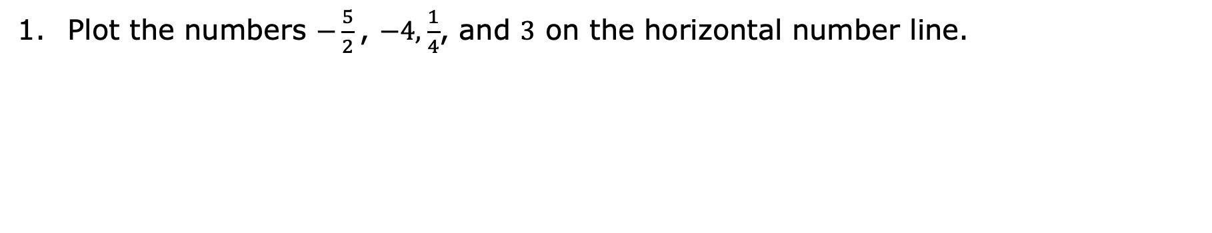
4.1.6 Try It: Plotting Rational Numbers on a Number Line
Plot the numbers $−\frac{5}{2}$ , $−4$, $\frac{1}{4}$, and $3$ on the horizontal number line.
volume 1, pg. 140

Slide 28
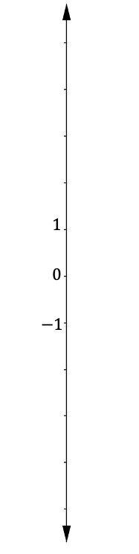
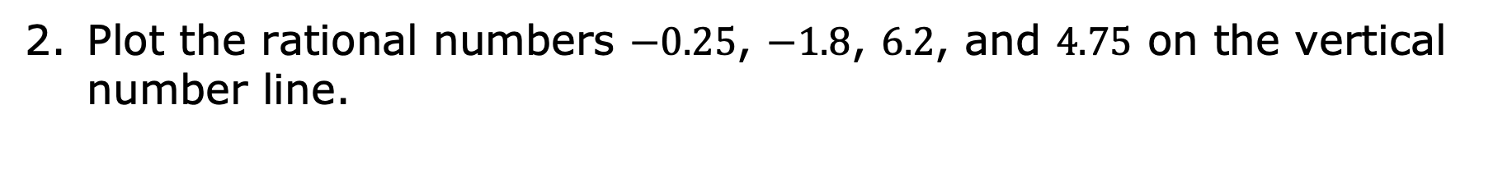
Plot the rational numbers $−0.25$, $−1.8$, $6.2$, and $4.75$ on the vertical number line.
volume 1, pg. 140

Slide 29

Your Turn
volume 1, pg. 141

Slide 30
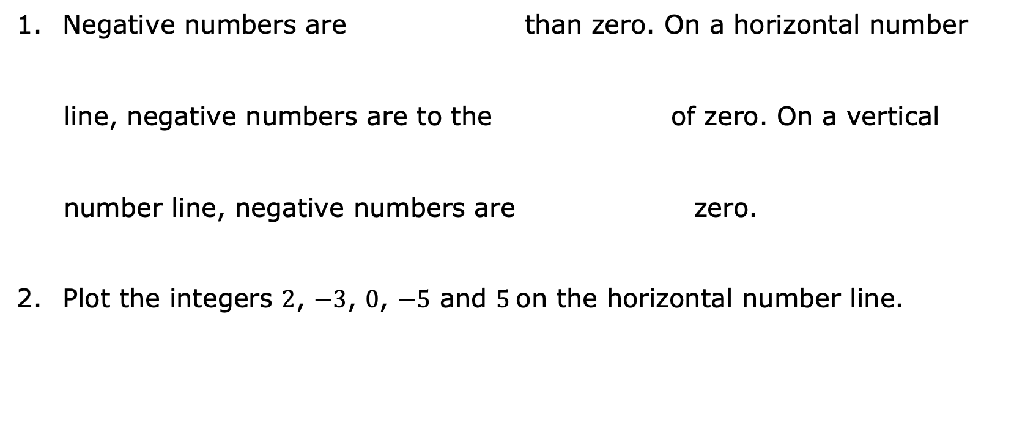
4.1.7 Your Turn!
greater
less
Negative numbers are than zero. On a horizontal number
line, negative numbers are to the of zero. On a vertical
number line, negative numbers are zero.
Plot the integers $2$, $−3$, $0$, $−5$ and $5$ on the horizontal number line.
right
left
above
below
volume 1, pg. 141

Slide 31
Plot the rational numbers $−1\frac{1}{5}$,$−\frac{4}{5}$,$2$, and $\frac{6}{5}$ on the vertical number line.
volume 1, pg. 141

Slide 32

Wrap-Up
volume 1, pg. 141

Slide 33

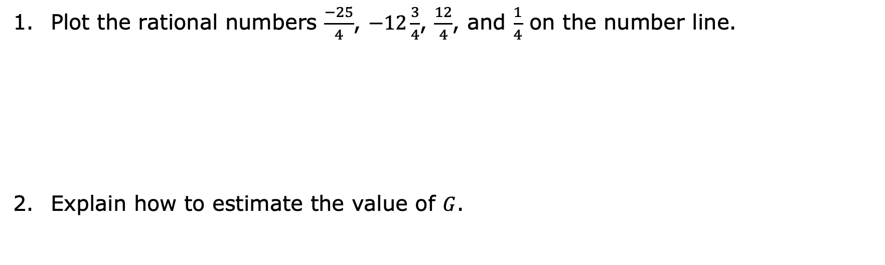
4.1.8 Wrap-Up: Ticket Out the Door
Plot the rational numbers $\frac{−25}{4}$, $−12\frac{3}{4}$, $\frac{12}{4}$, and $\frac{1}{4}$ on the number line.
Explain how to estimate the value of $G$.
volume 1, pg. 141

